Slide 1
BVZF Algemene Vergadering 2020 SBPH Assemblée Générale 2020
Notes:
1
1

Slide 2
Welcome
Members
Financial report 2019 and Budget 2020
Workgroup reports
Future Symposia
Proposals
Board
Votes
Varia
Notes:
2

Slide 3
Welcome
Members
Financial report 2019 and Budget 2020
Workgroup reports
Future Symposia
Proposals
Board
Votes
Varia
Notes:
3

Slide 4
Members to be voted
Name | Type | Location | Ref1 | Ref2
Van Vooren Jelmer | effective | AZ sint-jan | Dominique Staelens | Bert Bakelandt
Hespeels Felicien | effective | uclouvain | Olga Koshariuk | Aurélie Blavier
Delree Melissa | effective | uclouvain | Olga Koshariuk | Aurélie Blavier
Roger Véronique | effective | uclouvain | Olga Koshariuk | Aurélie Blavier
Merken Karen | effective | uz leuven | Hilde Bosmans | Nicholas Marshall
Gerardi Andrea | effective | UZ Brussel | ? | ?
Gwenny Verfaillie | effective | Ugent | An De Hauwere | Klaus Bacher
Marieke De Rydt | effective | AZ Sint Jan | Bert Bakelandt | Sophie Verschuere
Ali Dabach | effective | Chirec | Soufian Audia | Laila Nafaa
Angelique Pirenne | effective | Europaziekenhuizen | Alex Rijnders | Odile Michel
Tom Vercauteren | effective | UZ Gent | Barbara Vanderstraeten | Frederik Vanhoutte
Verdi Vanreusel | effective | Iridium | Geert De Kerf | Dirk Verellen
Notes:
4

Slide 5
Members to be voted
Name | Type | Location | Ref1 | Ref2
Derrien Johathan | corresponding | ISIB | Gwennaëlle Marin | Soufian Audia
Cristina Boso Martinez | corresponding | UZ Leuven | Karel Aerts | Bertrand Dewit
Lena Feringa | corresponding | Iridium | Piet Stevens | Dirk Verellen
Name | Type | Location | Ref1 | Ref2
Claessens Michael | student | Uantwerpen | Piet Stevens | Dirk Verellen
Sulaiman Alvaro | student | uzleuven | Tom Depuydt | Hilde Bosmans
Sevenois Matthijs | student | uzleuven | Kristof Baete | Wies Deckers
Debouvere Senne | student | controlatom | Tom Meylaers | Sébastien Lichtherte
Notes:
5

Slide 6
Renew Website
Set up mail feeds
Automated Membership management
Page with the different working groups active in BHPA
Repository with document better organized as compared to now separated in criteria set up by us: year of creation, RX, RT or NM, type of article,…
Make website GDPR compliant
Renew homepage
Notes:
6

Slide 7
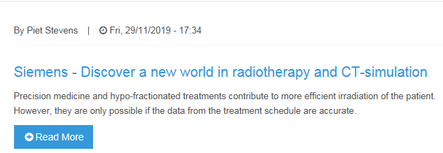
Contact
Symposium
Jobs
Member page
Professional matters
Working groups
MPE in Belgium
Documents
Board
Legislation
Honorary Members
FANC
Professional matters
Radiology
RT-24
Nuclear medicine
Taskforce New Norms
NKI
Nuclear medicine
Radiology
Radiotherapy
Become Member
Nuclear medicine
Radiology
Radiotherapy
Links
Mission statement:
Bring together Belgian Medical Physicists to share and improve the knowledge for the benefit of patients
Medical Physicists
The clinical physicist is a medical specialist with a good understanding of physical principles. The clinical physicist ensures that new and existing medical equipment and techniques are applied safely and responsibly to optimize the diagnosis and treatment of patients.
An extensive profile of the clinical physicist can be found here.
News:
Highlight 2

Slide 8
Symposium
Medical Physicists
The clinical physicist is a medical specialist with a good understanding of physical principles. The clinical physicist ensures that new and existing medical equipment and techniques are applied safely and responsibly to optimize the diagnosis and treatment of patients.
An extensive profile of the clinical physicist can be found here.
News:
Highlight 2
Who is who in Belgium
Are you looking for a MPE in belgium click here
Who is who
EFOMP
BESTRO
NVKF
VVRO
AFITER
VMBV
IAEA
AAPM
IOMP
Social Media
Reference laboratories
VSL
PTW
SCK

Slide 9
We need bèta testers
Who wants to help?
Notes:
9

Slide 10
Welcome
Members
Financial report 2019 and Budget 2020
Workgroup reports
Future Symposia
Proposals
Board
Votes
Varia
Notes:
10

Slide 11
Financial Report 2019: DEBIT
Debit 2019
Memberships (NCS, EFOMP,IOMP) | € 2.106,75
Working BHPA | € 50,00
Account costs | € 45,25
Catering / Rooms Workgroups | € 1.520,87
Reimbursement | € 3.175,00
Symposium 2020 | € 19.656,56
Total Expenses | € 26.554,43
Notes:
11

Slide 12
Financial Report 2019: CREDIT
Credit 2019
Memberships | € 6.670,00
Sponsors | € 5.600,00
Reimbursement | € 1.150,10
Internal transfers | € 48.453,30
Total Incomes | € 61.873,40
Balance | € 35.318,97
Accounts 31/12/2019
Checking | € 79.583,28
Savings | € 118.875,54
Balance | € 198.458,82
Notes:
12

Slide 13
Symposium 2019
Revenues
Technical exhibition booths + extra participants (incl social event and hotel) |  |  | € 34.867,00
Sponsoring BHPA Young Physicist Award |  |  | € 500,00
Sponsoring RaySearch and BHPA |  |  | € 907,33
Registration participants (incl social event and hotel) |  |  | € 35.227,00
Total revenues |  |  | € 71.501,33
Expenses
Kaai 17: location and cathering |  |  | € 34.433,57
Expenses invited speakers |  |  | € 878,72
Social Event + hotel |  |  | € 20.077,33
MDEON |  |  | € 580,80
Award Young Physicist |  |  | € 500,00
Website (WebReus + payment webmaster) |  |  | € 526,98
Conference bags + badges |  |  | € 478,32
Various expenses |  |  | € 168,68
Total expenses |  |  | € 57.644,40
BALANCE: difference IN-OUT |  | + | € 13.856,93
Notes:
13

Slide 14
VZW/ ASBL mandatory questions:
Does a non-board member wants to examine to account?
Agree to discharge the responsibilities of the board on budget of former years?

Slide 15
Budget 2020 : DEBIT
Estimated Expenses 2020
Working Board | € 300,00
Memberships (NCS, EFOMP,IOMP) | € 1.400,00
Insurances | € 900,00
Subscription (VSDC) | € 100,00
Material + calibibration primary chamber (purchase phantom) | € 4.000,00
Working Groups (NCS, EFOMP) | € 1.000,00
Education | € 500,00
Symposium | € 5.000,00
Account Costs | € 50,00
Audits | € 250,00
Web | € 25.000,00
Invoice for old website | € 12,000,00
Total Estimated Expenses | € 50.500,00
Notes:
15

Slide 16
Budget 2020 : CREDIT
Estimated Incomes 2020
Memberships | € 7.000,00
Main Sponsors | € 5.000,00
Simple Sponsors | € 1.000,00
Rentings | € 400,00
Working groups | € 3.000,00
Education | € 250,00
Symposium | € 10.000,00
Interests | € 50,00
Total Estimated Incomes | € 26.700,00
Balance | - € 23.800,00
Notes:
16

Slide 17
Welcome
Members
Financial report 2019 and Budget 2020
Workgroup reports
Future Symposia
Proposals
Board
Votes
Varia
Notes:
17

Slide 18
Professional Matters

Slide 19
Nuclear Medicine
Bruno Vanderlinden

Slide 20
BHPA NM Workgroup 19
3 global meetings
3 sub group, task:
QC for PETScan
QC for Gamma Camera
MPE trainee supervision
Continual Education:
Practical dosimetry for radioembolisation
Future sub group, task:
QC for radionuclide calibrator (with automated injector)
QC for probe
Next meeting @ FANC Thursday 5 march 10h-13h

Slide 21
RadiologY
Hilde Bosmans

Slide 22
Working group radiology
Fluoroscopic imaging
March 22 & May 24
Mammography update
May 10, June 18 and Dec 10, 2019
Dental & orthopedic CBCT
Jan 20, Sept 13 2019 and Jan 7 2020
Several meetings in the FANC to discuss the FANC decrees
(Eutempe-RX course in Leuven)

Slide 23
Working group radiology
2020
International Workshop Breast Imaging. May 24-27, 2020 (Leuven)
Event to be defined May 6 or 7, 2020 in Leuven
Awaiting input of the colleagues for the QC files…
Awaiting the new Belgian legislation

Slide 24
EFOMP
Hilde Bosmans

Slide 25
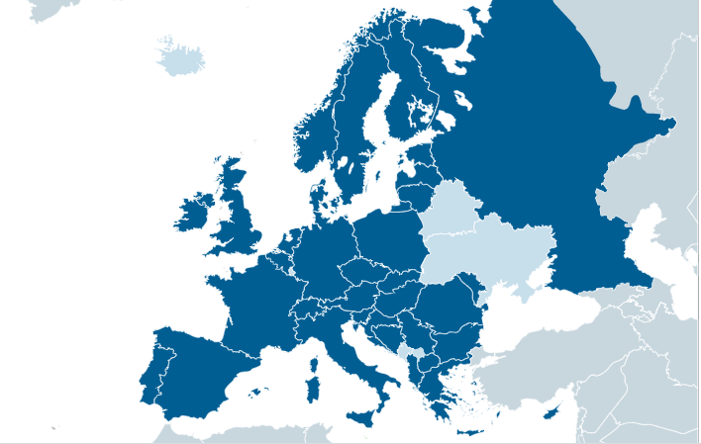
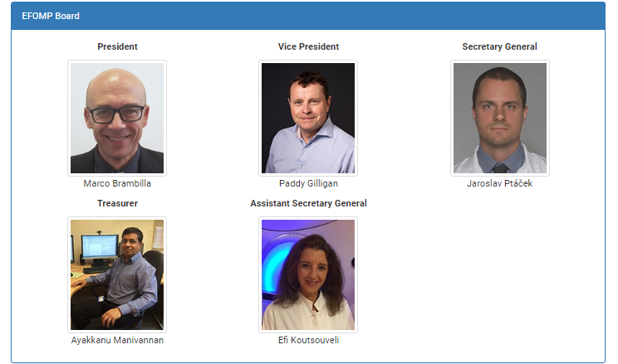
Committees: education, EU matters, professional matters, communication, science and projects

Slide 26
EFOMP, annual meeting in Poland, Sept 2019
EFOMP wishes to involve in its activities as many Medical Physicists as possible. At the same time, it reiterates, that EFOMP is a Federation of National Member Organisations and it does not wish to weaken that aspect of its structure. To this end it has created a new class of membership called Individual Associate Membership (IAM).

Slide 27
Activities
EFOMP newsletter
Calendar of activities
3rd European Congress of Medical Physics, September 23-26, 2020, Torino
4th European Congress of Medical Physics, Aug 17-20, 2022, Dublin
5th?
ESMPE school, the EUTEMPE-RX school, a new online platform with teaching material
The European Diploma
Projects
Professional matters
EU and international matters

Slide 28
WG in the EFOMP / science committee
1. “Revision of EFOMP PS14 - Safety of MRI”. The WG will operate from June 2019 to June 2020 (BHPA delegate: Timo Debondt)
2. “Breast Tomosynthesis QC Protocol”. The WG will operate from April 2019 to March 2021. (BHPA delegate: Nick Marshall)
3. “Artificial Intelligence (AI)”. The WG will operate from Jun 2019 to Apr 2021. (presided by Federica Zanca)
4. “Angiographic and fluoroscopic systems - QC protocol”. The WG will operate under Scientific Committee from Jun 2019 to Jun 2021. (BHPA delegate Hilde Bosmans)

Slide 29
Radiotherapy (RT-24)
Frederik Vanhoutte

Slide 30
RT-24
Preparation for RD
Finalized: list of exemptions Article 8 “verification of dose delivery”
BHPA vision text on acceptable methodologies of patient treatment verification: draft to be expected in april

Slide 31
Taskforce New Norms

Slide 32
NCS
Alex Rijnders

Slide 33
Current subcommittees
Code of practice and recommendations for TBI/TSI: (2014)
CoP and recommendations SBRT (2016)
Protontherapy (2016)
QC of Linacs (2017)
MRI QA for RT (2017)
Notes:
TBI-TSI: Geert Pittomvils, Françoise Vaneste

Slide 34
Current subcommittees
QA of treatment planning systems (2018)
IORT – IOBT (2018)
Deformable Image Registration (2019)
Published in 2019:
QA of CBCT in radiotherapy
See NCS website “Radiationdosimetry.org”
Notes:
TPS: Antoine Delor, Wouter Crijns, Younes Jourani
IORT: Piet Stevens, Nicolas Hertsens, Stephane Simon, Marleen Piessens

Slide 35
Welcome
Members
Financial report 2019 and Budget 2020
Workgroup reports
Future Symposia
Proposals
Board
Votes
Varia
Notes:
35

Slide 36
Symposia in the future
2021: Leuven
2022: Baudour
2023: Iridium
2024:
2025:
Notes:
36

Slide 37
Welcome
Members
Financial report 2019 and Budget 2020
Workgroup reports
Future Symposia
Proposals
Board
Votes
Varia
Notes:
37

Slide 38
Professional union
Cfr professional matters
Includes non hospital physicist to effective members
Separate from BHPA? Or change statutes
Change official address
Name?
Extraordinary general assembly to be organized
To Be Decided: March 2th/4th/11th/13th at FANC
Notes:
Bie de ost, Edmond Sterpin Tomo
Rita Reyme,, Alex
TBI/TSI: chair Geert, Maxime Coevoet, Nicolas Hermand UZ leuven

Slide 39
Welcome
Members
Financial report 2019 and Budget 2020
Workgroup reports
Future Symposia
Proposals
Board
Votes
Varia
Notes:
39

Slide 40
BHPA Board
Statute: Terms of 2 years, 4-6 members
End of term, renewing term: Piet Stevens
Mid-term: Nico Buls, Sébastien Lichtherte, Jan Vandecasteele, Alain Sottiaux
Leaving Board: /
New candidate: Claire Bernard
Notes:
40

Slide 41
Welcome
Members
Financial report 2019 and Budget 2020
Workgroup reports
Future Symposia
Proposals
Board
Votes
Varia
Notes:
41

Slide 42
Welcome
Members
Financial report 2019 and Budget 2020
Workgroup reports
Future Symposia
Proposals
Board
Votes
Varia
Notes:
42

Slide 43
Thank you !
Notes:
43

