Slide 1
BVZF Algemene Vergadering 2021 SBPH Assemblée Générale 2021
Notes:
1
1

Slide 2
Welcome
Approval of 2020 financial report,
Discharge of Board for 2020,
Approval of the 2021 budget,
Board composition,
New members,
BHPA as professional Union.
Notes:
2

Slide 3
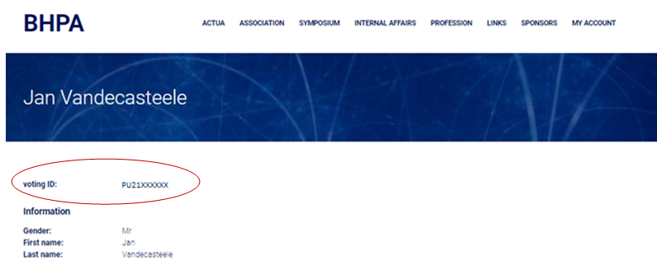
How to vote?
Look up your voting ID on the BHPA.eu website:
Notes:
3

Slide 4
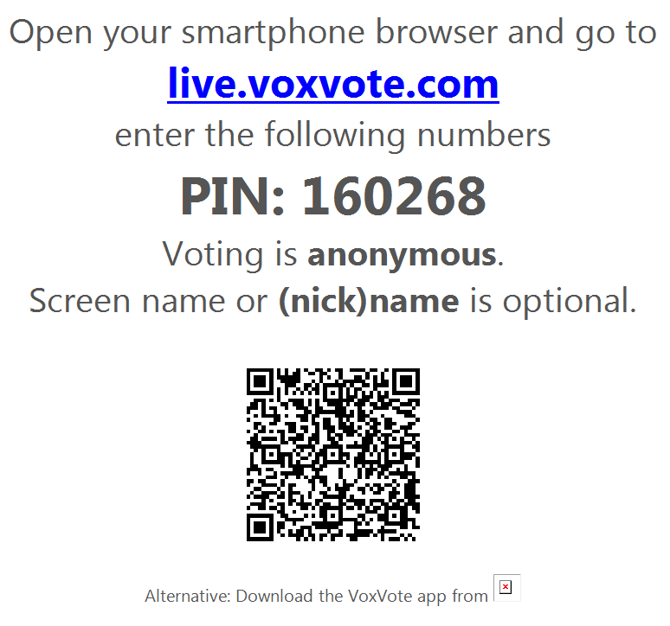
Notes:
4

Slide 5
Notes:
5

Slide 6
For people with a proxy/convocation/volmacht:
Vote offline after the meeting via microsoft forms for your 2nd or 3rd vote
(maximum 2 proxy per member)
Link will be given at the end of this presentation
Available until 21h 29/03/2021
In case of problems contact the board !!
Jan.vandecasteele@azstlucas.be

Slide 7
Welcome
Approval of 2020 financial report,
Discharge of Board for 2020,
Approval of the 2021 budget,
Board composition,
New members,
BHPA as professional Union.
Notes:
7

Slide 8
Financial Report 2020
Debit 2020
Website | € 24.411,86
Working BHPA | € 26,30
Account costs | € 42,10
Catering / Rooms Workgroups / Travel | € 772,66
Memberships | € 2.103,43
Total Expenses | € 27.356,35
Notes:
8

Slide 9
Financial Report 2020
Credit 2020
Memberships | € 8.100,00
Sponsors | € 300,00
Symposium 2020 | € 1.685,00
Total Incomes | € 10.085,00
Balance | € -17.271,35
Accounts 31/12/2020
Checking | € 62.311,93
Savings | € 118.875,54
Balance | € 181.187,47
Notes:
9

Slide 10
Symposium 2020
IN
Participants: 43805 44035
Firms: 54950,95 55100
Total 98755,95 99.135,00€
OUT
LouvExpo: 95317,18€ (payé)
Dégât Exposant : 124,86€ (payé)
DJ 550€ (payé)
Invited speakers
Hôtel : 765€ (payé)
107,5€ (Wouters Crijns) (paid)
Transport: 26,6€ (Jennifer Dhont) (payé)
108€ (Alberto Traverso) (payé)
Resto : 234€ (payé) with Marco Brambilla
397€ (payé) with invited speakers
Cadeaux : 418,36€ (payé) (chapelle)
35,35€ (payé) (envoi)
(10 orateurs hors BHPA à 90€ = 900€) (1 firm removed (Bracco) last day= 1240€)
Koen Cobbaert 847€ (payé)
Mdeon 290,4€ (payé)
Young Award 500€ (payé)
Assurance 71,01€ (payé)
Kickers (3) 490€ (payé)
Thomas 737,85€ (payé)
Toiles (Ecrans) 239,98€
Badges (2x50) 33,18€
Tours de cou (100) 27,59€
Tours de cou (100) 27,59€
Badges (50) 16,59€
Badges (400) 119,92€
Sweats (21) 273€
Silvana 90€ (payé)
Pointeurs laser 70€
Sweats (2) 20€
Fred 58,89€ (payé)
Bac à bec 58,89€
Marie 23,96€ (payé)
Colliers+ciseaux 23,96€
Photomaton 428,99€ (payé)
Cadres pour toile 865,15€ (payé)
Total 102.487,10 €
Balance = -3.352,10€
Notes:
10

Slide 11
Please VOTE
Do you approve the 2020 financial report?
Notes:
11

Slide 12
Welcome
Approval of 2020 financial report,
Discharge of Board for 2020,
Approval of the 2021 budget,
Board composition,
New members,
BHPA as professional Union.
Notes:
12

Slide 13
VZW/ ASBL mandatory questions:
Does a non-board member wants to examine to account?
Agree to discharge the responsibilities of the board on budget of 2020 ?

Slide 14
Please VOTE
Do you discharge the board for 2020?
Notes:
14

Slide 15
Welcome
Approval of 2020 financial report,
Discharge of Board for 2020,
Approval of the 2021 budget,
Board composition,
New members,
BHPA as professional Union.
Notes:
15

Slide 16
Budget 2021 : DEBIT
Estimated Expenses 2021
Working Board | € 5.000,00
Memberships (NCS, EFOMP,IOMP) | € 1.600,00
Insurances | € 500,00
Subscription (VSDC) | € 1.000,00
Material (purchase electrometer) | € 10.000,00
Working Groups (NCS, EFOMP) | € 1.000,00
Education | € 500,00
Symposium | € 10.000,00
Account Costs | € 50,00
Audits | € 250,00
Website | € 15.000,00
Total Estimated Expenses | € 44.900,00
Notes:
16

Slide 17
Budget 2021 : CREDIT
Estimated Incomes 2021
Memberships | € 9.000,00
Main Sponsors | € 8.750,00
Simple Sponsors | € 1.200,00
Rentings | € 400,00
Working groups | € 3.000,00
Education | € 250,00
Symposium | € 10.000,00
Interests | € 50,00
Total Estimated Incomes | € 32.650,00
Balance | € (-12.250,00)
Notes:
17

Slide 18
Please VOTE
Do you approve the 2021 budget?
Notes:
18

Slide 19
Welcome
Approval of 2020 financial report,
Discharge of Board for 2020,
Approval of the 2021 budget,
Board composition,
New members,
BHPA as professional Union.
Notes:
19

Slide 20
BHPA Board
Statute: Terms of 2 years, 4-6 members
End of term, renewing term: Nico Buls, Sébastien Lichtherte, Jan Vandecasteele, Alain Sottiaux
Mid-term: Piet Stevens, Claire Bernard
Leaving Board: /
New candidate:/
Notes:
20

Slide 21
Please VOTE
Do you approve the BHPA board composition?
Notes:
21

Slide 22
Welcome
Approval of 2020 financial report,
Discharge of Board for 2020,
Approval of the 2021 budget,
Board composition,
New members,
BHPA as professional Union.
Notes:
22

Slide 23
Members to be voted
Name | Type | Location | Ref1 | Ref2
Aline Delbaere | Effective | AZ Delta | Jan Vandecasteele | Piet Stevens
Palakpreet Singh | Effective | Iridium | Dirk Verellen | Lieselotte Depuydt
Lorenzo Mela | Effective | Grand Hopital de Charleroi | Michael Del Re | Aurélie Druart
Zelda Paquier | Effective | Bordet | Younes Jourani | Nick Reynaert
Gilke Polfliet | Effective | OLV Aalst | Nadine Linthout | Pol Decroos
Karen Merken | Effective | UZ Leuven | Hilde Bosmans | Nicholas Marshall
Michiel Dehairs | Effective | UZ Leuven | Hilde Bosmans | Nicholas Marshall
Tom Dresselaers | Effective | UZ Leuven | Hilde Bosmans | Nicholas Marshall
Frederik De Keyzer | Effective | UZ Leuven | Hilde Bosmans | Nicholas Marshall
Lesley Cockmartin | Effective | UZ Leuven | Annelies Jacobs | Kim Lemmens
Chahrazad Benazzouz | Corresponding | UZ Leuven | Tom Depuydt | Jan Verstraete
Notes:
23

Slide 24
Members to be voted
Name | Type | Location | Ref1 | Ref2
Elli Dimitriadi | Corresponding | CHU de Liège | Claire Bernard | Christophe Mercier
Lindsay Folens | Corresponding | AZ groeninge | Els Verhenne | Nikie Planckaert
Jorik Debonnet | Corresponding | AZ groeninge | Els Verhenne | Nikie Planckaert
Jan Moens | Corresponding | AZ groeninge | Els Verhenne | Nikie Planckaert
Cindy Bastiaansen | Corresponding | Iridium | Dirk Verellen | Lieselotte Depuydt
Nancy Janssens | Corresponding | Iridium | Dirk Verellen | Lieselotte Depuydt
Virginie Kinnard | Student | CHU Brugmann | Kristof Baete | Wies Deckers
Ariane Razavi | Student | St Luc | Françoise Vanneste | David Dechambre
Anneleen Nijs | Student | OLV Aalst | Nadine Linthout | Pol Decroos
Domitien Bertrand | Student | Saint-Luc | Françoise Vanneste | Antoine Delor
Hannah Loots | Student | LOC | Kristof Baete | Heidi Andries
Liesbeth Vandewinckele | Student | UZ Leuven | Wouter Crijns | Tom Depuydt
Notes:
24

Slide 25
Members to be voted
Name | Type | Location | Ref1 | Ref2
Olivier BLEUSE | Student | Bordet | Younes Jourani | Nick Reynaert
Aurélian Quinet | Student | Bordet | Younes Jourani | Nick Reynaert
Cédric Devroye | corresponding | UZ Leuven | Tom Depuydt | Wouter Crijns
Koen Salvo | Effective | UZ Leuven | Tom Depuydt | Kenneth Poels
Hannelore Verhoeven | Student | UZ Leuven | Joke Binst | Kim Lemmens
Peter Vereecken | Associated | Varian | - | -
Notes:
25

Slide 26
Please VOTE
Do you accept these new members?
Notes:
26

Slide 27
Welcome
Approval of 2020 financial report,
Discharge of Board for 2020,
Approval of the 2021 budget,
Board composition,
New members,
BHPA as professional Union.
Notes:
27

Slide 28
BHPA as professional union
The following proposition is the result of a long running discussion and consensus:
6 professional matters – meetings (2019 – 2021)
2 virtual meetings for everybody to give feedback
Resulting in the current proposition
Notes:
28

Slide 29
BHPA as professional union
Update Statutes to be compliant to new asbl/vzw legislation
http://www.bhpa.eu/statutesNL
http://www.bhpa.eu/statutesFR
Notes:
29

Slide 30
What has changed?
Update Statutes to be compliant to new asbl/vzw legislation
Each non-profit organization must adapt its articles of association to the provisions of the new code by January 1, 2024;
A new definition for the non-profit organization, without limitation on the number of commercial activities, but with a prohibition on profit distribution and on capital advantages;
A non-profit organization must pursue a selfless goal in the context of specific activities that it has as its object; purpose and object must be clearly described under the articles of association;
A non-profit organization may only use a name that is not yet in use by another legal entity;
A non-profit organization can be set up with two people and no longer has to be with three;
Change in terminology: board of directors becomes administrative body, internal house regulations become internal regulations;
The general meeting must be no longer larger than the administrative body;
Statutory representation in and out of court only accrues to directors.
Daily management is finally getting a legal definition;
In all acts binding the non-profit association, the signature of the person representing the non-profit association must state in which capacity he or she is acting;
The liability of the directors is clearly defined by law;
Non-profit organizations will be divided according to size: small, other than small and micro non-profit organizations;
New mandatory statements are required on the outgoing documents of a non-profit organization.
The power of the general meeting are broader and more clearly defined; -
The notice period for the general meeting will be extended from 8 to 15 days;
Excluding a member from the general meeting becomes more difficult;
It is generally no longer possible to deviate from the agenda of the general meeting;
Directors can in certain cases co-opt directors themselves;
Written decision-making for the administrative body is introduced;
A conflict of interest scheme for directors is introduced;
Decisions according to the rules of deliberative meetings is the norm;
Legal entities-directors must appoint a permanent representative in the administrative body.

Slide 31
BHPA as professional union
2. Change BHPA from scientific organization to professional union.
Updated membership organisation and reinstate scientific board
Define condition to become board member, duration of mandate
Define sanctions when non compliant to code of professional conduct
the commitment to seek, together with the other party, the means to settle any dispute about the working conditions that the association enters into, either by conciliation or by arbitration.
Update internal rules of procedure (code of professional conduct from 2014)
http://www.bhpa.eu/new_membership
Notes:
31

Slide 32
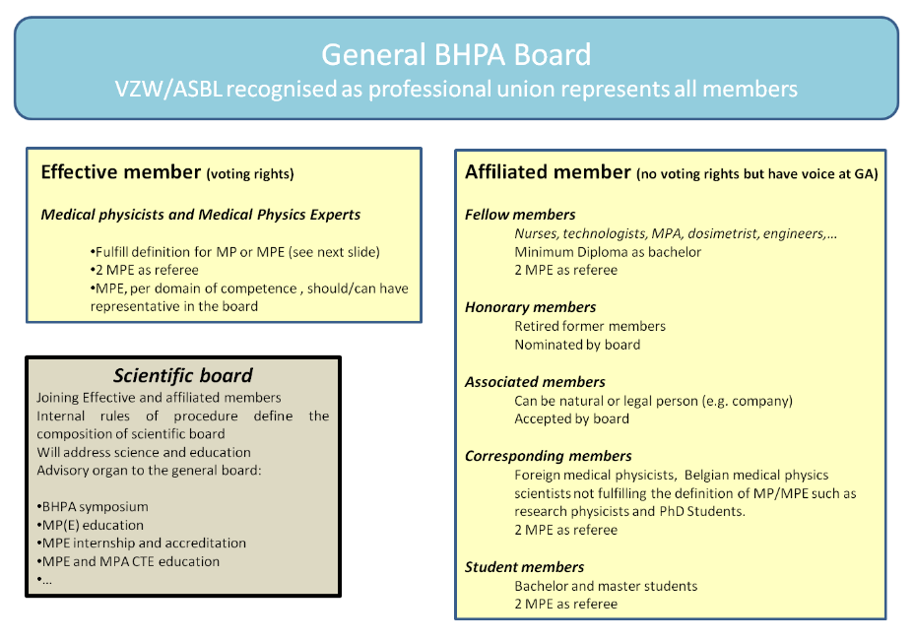

Slide 33
What has changed?
Before we vote:
Statutes change only valid:
General assembly with 2/3e of the members present or represented.
Effective members:149
Necessary amount of members to change statutes: 99
To change of purpose of vzw/asbl/NPO : 4/5e of the votes in favor of change
e.g. Minimum: 79 of 99 in favor of change
→ In case 2/3 is of members is not achieved: extra ordinary assembly where the amount of people present is not restrictive and at least 15 day after the first assembly → BHPA symposium

Slide 34
What has changed?
https://www.bhpa2021.eu/
REGISTER NOW!!!!!
Extra-ordinary General Assembly
on Thursday 29th of April:
Discussing the reports of the working groups,
Discussing the internal rules of procedures,
Discussion the scientific board

Slide 35
Please VOTE
Do you approve to change BHPA from scientific to professional union, the new membership system and be conform to the new legislation of VZW/ASBL?
Notes:
35

Slide 36
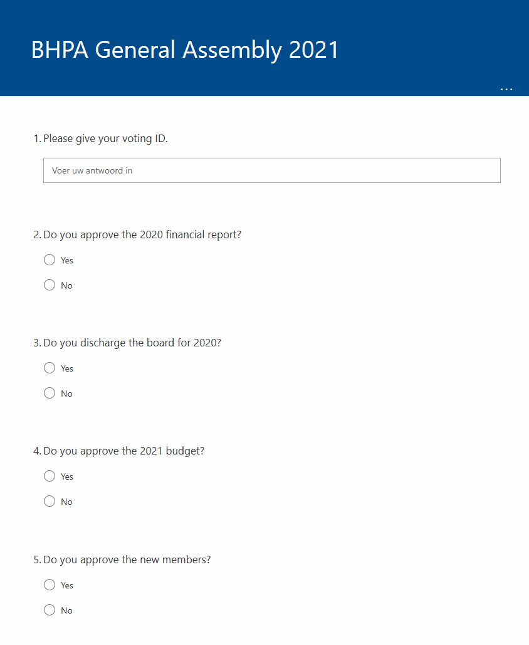
For people with a proxy/convocation/volmacht:
https://forms.office.com/r/FPRVHjKsRp
Vote offline via microsoft forms for your 2nd or 3rd vote
(maximum 2 proxy per member)
Available until 21h 29/03/2021
In case of problems contact the board !!
Jan.vandecasteele@azstlucas.be

Slide 37
Thank you !
Notes:
37

